Slide 1
Program Control:
Status bits, Conditional Branch Instructions, subroutine call and return program, interrupts and types
(Lectures 29-32)

Slide 2
Program Control

Slide 3
Program Control
Program Control:
Instructions are always stored in successive memory locations. When processed in the CPU, the instructions are fetched from consecutive memory locations and executed. Each time an instruction is fetched from memory, the program counter is incremented so that it contains the address of the next instruction in sequence. After the execution of a data transfer or data manipulation instruction, control returns to the fetch cycle with the program counter containing the address of the instruction next in sequence.
On the other hand, a program control type of instruction, when executed, may change the address value in the program counter and cause the flow of control to be altered. In other words, program control instructions specify conditions for altering the content of the program counter, while data transfer and manipulation instructions specify conditions for data-processing operations.

Slide 4
Program Control (Cont.)
Some typical program control instructions are listed in Table 1.
The branch and jump instructions are used interchangeably to mean the same thing, but sometimes they are used to denote different addressing modes. The branch is usually a one-address instruction. It is written in assembly language as BR ADR, where ADR is a symbolic name for an address. When executed, the branch instruction causes a transfer of the value of ADR into the program counter. Since the program counter contains the address of the instruction to be executed, the next instruction will come from location ADR.
Branch and jump instructions may be conditional or unconditional. An unconditional branch instruction causes a branch to the specified address without any conditions. The conditional branch instruction specifies a condition such as branch if positive or branch if zero. If the condition is met, the program counter is loaded with the branch address and the next instruction is taken from this address. If the condition is not met, the program counter is not changed and the next instruction is taken from the next location in sequence.

Slide 5
Program Control (Cont.)
The skip instruction does not need an address field and is therefore a zero-address instruction. A conditional skip instruction will skip the next instruction if the condition is met. This is accomplished by incrementing the program counter during the execute phase in addition to its being incremented during the fetch phase.
If the condition is not met, control proceeds with the next instruction in sequence where the programmer inserts an unconditional branch instruction.
Thus a skip-branch pair of instructions causes a branch if the condition is not met, while a single conditional branch instruction causes a branch if the condition is met.

Slide 6
Program Control (Cont.)
The call and return instructions are used in conjunction with subroutines.
The compare and test instructions do not change the program sequence directly. The compare instruction performs a subtraction between two operands, but the result of the operation is not retained. However, certain status bit conditions are set as a result of the operation.
Similarly, the test instruction performs the logical AND of two operands and updates certain status bits without retaining the result or changing the operands. The status bits of interest are the carry bit, the sign bit, a zero indication, and an overflow condition. The generation of these status bits will be discussed first and then we will show how they are used in conditional branch instructions.

Slide 7
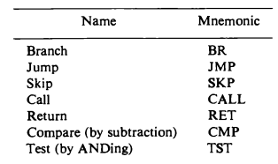
Program Control (Cont.)
Table 1. Typical program control instructions

Slide 8
Status Bits

Slide 9
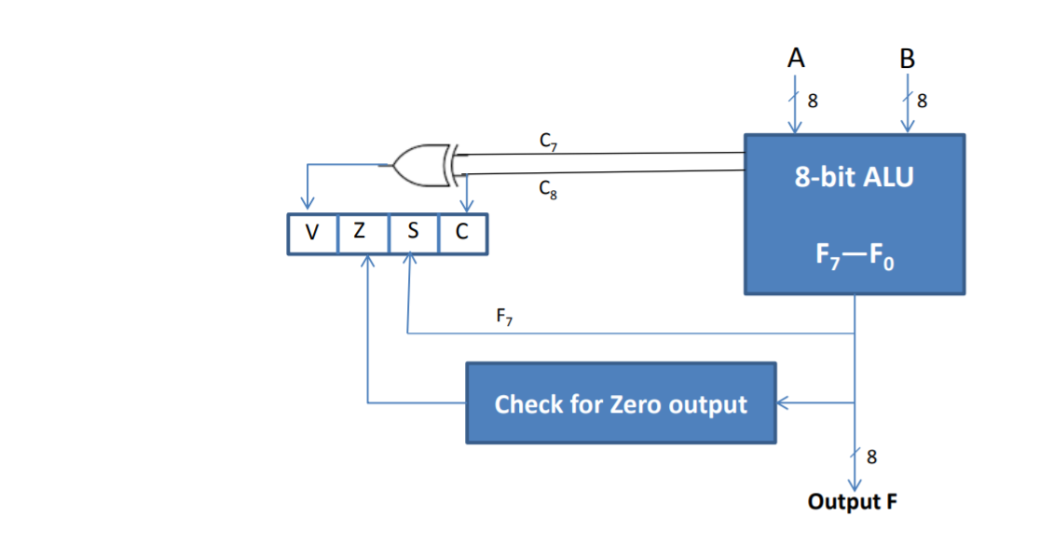
Program Control: Status Bits
The status register comprises the status bits.
The bits of the status register are modified according to the operations performed in the ALU.
The figure displays a block diagram of an 8-bit ALU with a 4-bit status register.
Fig. 1. Status Register bits

Slide 10
Program Control: Status Bits
The block diagram of an 8-bit ALU with a 4-bit status register shown in Fig. 1 which can be explained as follows:
The four status bits are symbolized by C, S, Z, and V. The bits are set or cleared as a result of an operation performed in the ALU.
1. Bit C (carry) is set to 1 if the end carry C8 is 1. It is cleared to 0 if the carry is 0.
2. Bit S (sign) is set to 1 if the highest-order bit F, is 1. It is set to 0 if the bit is 0.
3. Bit Z (zero) is set to 1 if the output of the ALU contains all O's. It is cleared to 0 otherwise.
In other words, Z = 1 if the output is zero and Z = 0 if the output is not zero.

Slide 11
Program Control: Status Bits
4. Bit V (overflow) is set to 1 if the exclusive-OR of the last two carries is equal to 1, and cleared to 0 otherwise. This is the condition for an overflow when negative numbers are in 2's complement.
For the 8-bit ALU, V = 1 if the output is greater than + 127 or less than - 128.
The status bits can be checked after an ALU operation to determine certain relationships that exist between the values of A and B . If bit V is set after the addition of two signed numbers, it indicates an overflow condition. If Z is set after an exclusive-OR operation, it indicates that A = B .

Slide 12
Conditional Branch Instruction

Slide 13
Program Control: Conditional Branch Instruction
In Conditional branch instructions, each mnemonic is constructed with the letter B (for branch) and an abbreviation of the condition name. When the opposite condition state is used, the letter N (for no) is inserted to define the 0 state. Thus BC is Branch on Carry, and BNC is Branch on No Carry.
If the stated condition is true, program control is transferred to the address specified by the instruction. If not, control continues with the instruction that follows.
The conditional instructions can be associated also with the jump, skip, call, or return type of program control instructions.

Slide 14
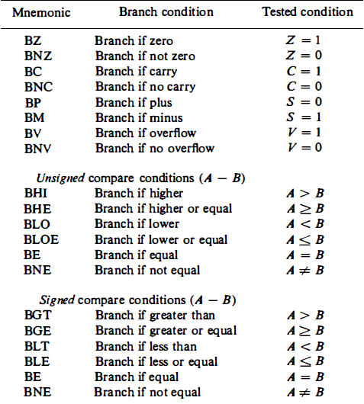
Conditional Branch Instruction||Table 2
Table2: Conditional Branch Instructions

Slide 15
Conditional Branch Instruction (Cont.)
The zero status bit checks if the result of the ALU is zero or not.
The carry bit checks if the most significant bit position of the ALU has a carryout. It is also used with rotate instruction to check whether or not the bit is shifted from the end position of a register into a carry position.
The sign bit indicates the state of the most significant bit of the output from the ALU (S = 0 denotes positive sign and S = 1 denotes negative sign).
The branch if plus and branch if minus is used to check whether the value of the most significant bit represents a sign or not.
The overflow and underflow instructions are used in conjunction with arithmetic operations performed on signed numbers.

Slide 16

Conditional Branch Instruction (Cont.)
Numerical example
Consider an 8-bit ALU as shown in Fig.1. The largest unsigned number that can be accommodated in 8 bits is 255. The range of signed numbers is between + 127 and - 128. The subtraction of two numbers is the same whether they are unsigned or in signed-2's complement representation (see Chap. 3).
Let A = 11110000 and B = 00010100. To perform A - B, the ALU takes the 2's complement of B and adds it to A .

Slide 17
Conditional Branch Instruction (Cont.)
The compare instruction updates the status bits as shown. C = 1 because there is a carry out of the last stage. S = 1 because the leftmost bit is 1 . V = 0 because the last two carries are both equal to 1, and Z = 0 because the result is not equal to 0.
If we assume unsigned numbers, the decimal equivalent of A is 240 and that of B is 20. The subtraction in decimal is 240 - 20 = 220. The binary result 11011100 is indeed the equivalent of decimal 220. Since 240 > 20, we have that A > B and A * B. These two relations can also be derived from the fact that status bit C is equal to 1 and bit Z is equal to 0. The instructions that will cause a branch after this comparison are BHI (branch if higher), BHE (branch if higher or equal), and BNE (branch if not equal).

Slide 18
Subroutine Call and Return

Slide 19
Program Control: Subroutine Call and Return
A Subroutine is a self contained set of instructions that perform a given computational task. During the execution of a program, a subroutine may be called to perform its function many times at various points in the main program.
Each time a subroutine is called, a branch is executed to the beginning of the subroutine to start executing its set of instructions.
After the subroutine has been executed, a branch is made back to the main program.

Slide 20
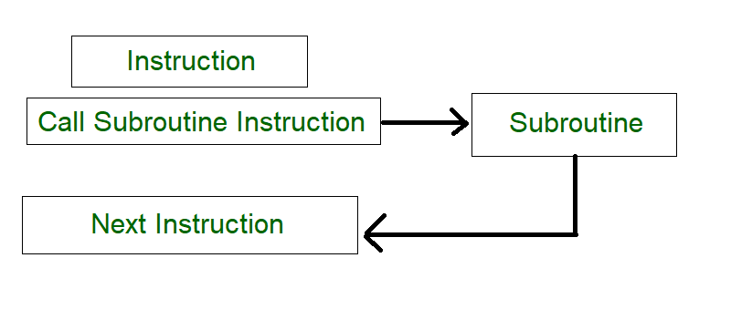
Subroutine Call and Return (Cont..)
The last instruction of every subroutine, commonly called return from subroutine, transfers the return address from the temporary location into the program counter. This results in a transfer of program control to the instruction whose address was originally stored in the temporary location.
Fig. 2 Subroutine flow

Slide 21
Subroutine Call and Return (Cont..)
The instruction that transfers program control to a subroutine is known by different names.
The most common names used are 1. call subroutine, 2. jump to subroutine, 3. branch to subroutine, or 4. branch and save address .
A call subroutine instruction consists of an operation code together with an address that specifies the beginning of the subroutine.
The instruction is executed by performing two operations: (1) the address of the next instruction available in the program counter (the return address) is stored in a temporary location so the subroutine knows where to return, and (2) control is transferred to the beginning of the subroutine.

Slide 22

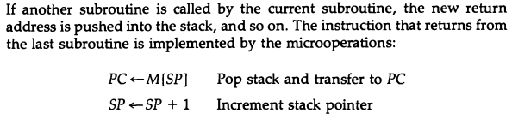
Subroutine Call and Return (Cont..)
A subroutine call is implemented with following micro-operations:
If another subroutine is called by the current subroutine, the new return addressed is pushed into the stack, and so on. The instructions that returns from the last subroutine is implemented by following micro-operations.

Slide 23
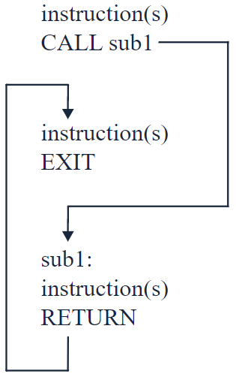
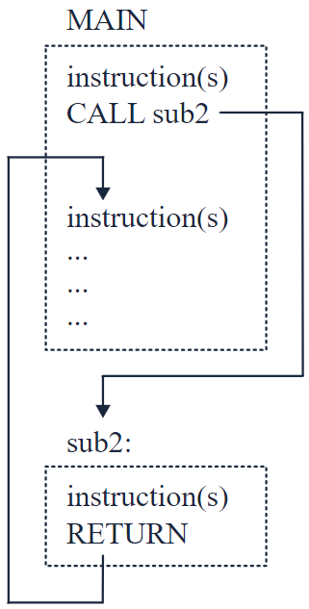
Subroutine Call and Return (Cont..)
(a)
(b)
Fig. 3. CALL and RETURN instructions (a) internal subroutine (b) external subroutine

Slide 24
Subroutine Call and Return (Cont..)
The CALL instruction interrupts the flow of a program by passing control to an internal or external subroutine. An internal subroutine (refer Fig 3(a)), is part of the calling program. An external subroutine is another program.
The RETURN instruction returns control from a subroutine back to the calling program and optionally returns a value.
When calling an internal subroutine, CALL passes control to a label specified after the CALL keyword. When the subroutine ends with the RETURN instruction, the instructions following CALL are processed.
When calling an external subroutine (refer Fig 3(b)), CALL passes control to the program name that is specified after the CALL keyword. When the external subroutine completes, you can use the RETURN instruction to return to where you left off in the calling program.

Slide 25
Program Interrupt

Slide 26
Program Control: Program Interrupt
Program interrupt is used to handle a variety of problems that arise out of normal program sequence. It refers to the transfer of program control from a currently running program to another service program as a result of an external or internal created request. Control returns to the initial program after the service program is implemented.
Interrupt procedure is similar to Subroutine call except for three variations:
1. The interrupt is usually initiated by external or internal signal rather than from the execution of an instruction (except for software interrupt).
2. The address of the interrupt service program is determined by the hardware rather than by the address field of the instruction.
3. Interrupt procedure stores all information necessary to define the state of the CPU rather than storing only the program counter.

Slide 27
Program Interrupt (Cont.)
After a program has been interrupted and the service routine been executed, the CPU must return to exactly the same state that it was when the interrupt occurred. Only if this happens will the interrupted program be able to resume exactly as if nothing had happened.
The state of the CPU at the end of the execute cycle (when the interrupt is recognized) is determined from:
1. The content of the program counter
2. The content of all processor registers
3. The content of certain status conditions
The collection of all status bit conditions in the CPU is sometimes called a program status word or PSW. The PSW is stored in a separate hardware register and contains the status information that characterizes the state of the CPU.

Slide 28
Program Interrupt (Cont.)
Typically, it includes the status bits from the last ALU operation and it specifies the interrupts that are allowed to occur and whether the CPU is operating in a supervisor or user mode.
Many computers have a resident operating system that controls and supervises all other programs in the computer. When the CPU is executing a program that is part of the operating system, it is said to be in the supervisor or system mode.
Certain instructions are privileged and can be executed in this mode only. The CPU is normally in the user mode when executing user programs. The mode that the CPU is operating at any given time is determined from special status bits in the PSW.

Slide 29
Types of Interrupt

Slide 30
Types of Interrupt
There are three major types of program interrupts that cause a break in the normal execution of a program.
They can be classified as:
1. External Interrupts
2. Internal Interrupts
3. Software Interrupts.

Slide 31
Types of Interrupt (Cont.)
External Interrupts
External interrupts come from input-output (l/0) devices, from a timing device, from a circuit monitoring the power supply, or from any other external source. Its examples are I/O device requesting transfer of data, I/O device finished transfer of data, elapsed time of an event, or power failure.
The timeout interrupt can result from a program that is in an endless loop and thus exceeded its time allocation.
Power failure interrupt can have as its service routine a program that transfers the complete state of the CPU into a non-destructive memory in a few milliseconds before power ceases.

Slide 32
Types of Interrupt (Cont.)
2. Internal Interrupts
Internal interrupts arise from illegal or erroneous use of an instruction or data. Internal interrupts are also called traps. These error conditions generally appear as a result of premature termination of the instruction execution. The service program that processes the internal interrupt determines the corrective measure to be taken.
The main difference between internal and external interrupts is that the internal interrupt is initiated by some exceptional condition caused by the program itself rather than by an external event.
Internal interrupts are synchronous with the program while external interrupts are asynchronous.
If the program is rerun, the internal interrupts will appear in the same place each time. External interrupts depend on external conditions that are independent of the program being executed at the time.

Slide 33
Types of Interrupt (Cont.)
3. Software Interrupts
A software interrupt is initiated by executing an instruction.
A software interrupt is a special call instruction that behaves like
an interrupt rather than a subroutine call.
It can be used by the programmer to initiate an interrupt procedure
at any desired point in the program.
The most common use of software interrupt is associated with a
supervisor call instruction. This instruction provides means for
switching from a CPU user mode to the supervisor mode.
Certain operations in the computer may be assigned to the
supervisor mode only, as for example, a complex input or output
transfer procedure.

Slide 34
THANK YOU

